Slide 1
Weekly Slides
University of Washington
ENGINE TEAM - NASA JPL
04 MAR 2024

Slide 2
Research Areas
Extreme Value Analysis
Chris (Jui-Wei)
Amy (Shiyun)
Network Analysis
Sean
Doria (Jiaqi)
Machine Learning
Long
Mazzy
Tung

Slide 3
Extreme Value Analysis
Objective: Research and analyze data for related parameter for hazard forecasting
Approach:
Compare and Integrate different datasets to find out essential parameters
Datasets:
SuperMAG Data
NERC
North American electricity power-grid and communication-network anomalies for several magnetic storms
Voltages measured on long grounded electrically conducting lines in North America during several magnetic storms, 1891-1940 (Insufficient data?)

Slide 4
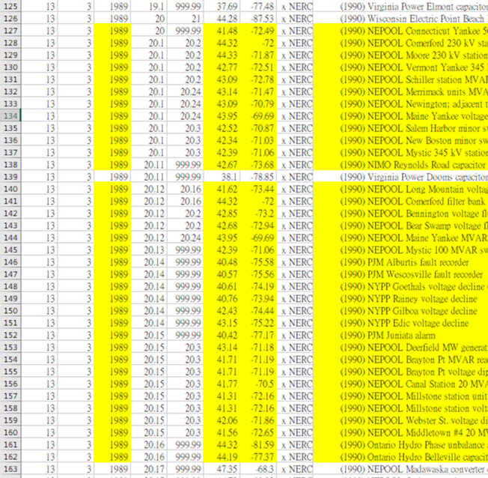
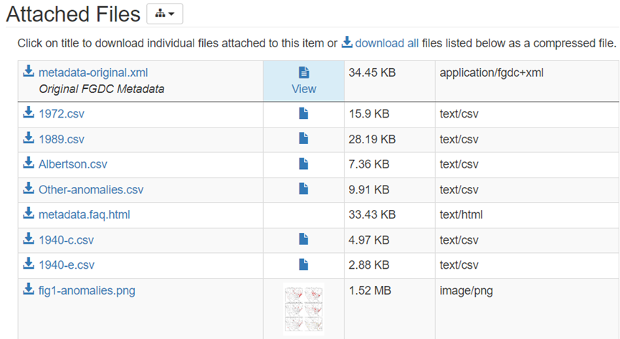
Approach
Dataset of “North American electricity power-grid and communication network anomalies for several magnetic storms”
Yellow part highlights the nearby incidents

Slide 5
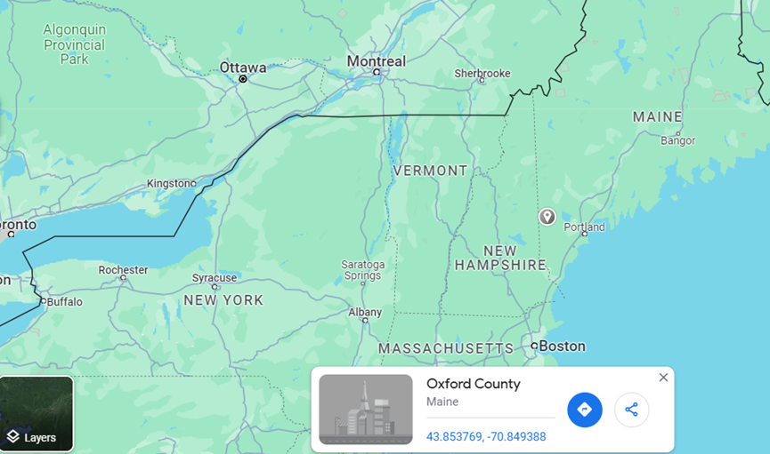
After peaking into the data, there are dozens of powergrid hazard happened around “Mar 13” at the similar location “latitude41~43 : longtitude -70~-73”. In the SuperMAG data of 1989 A.D, the nearest station is “Ottawa station”

Slide 6
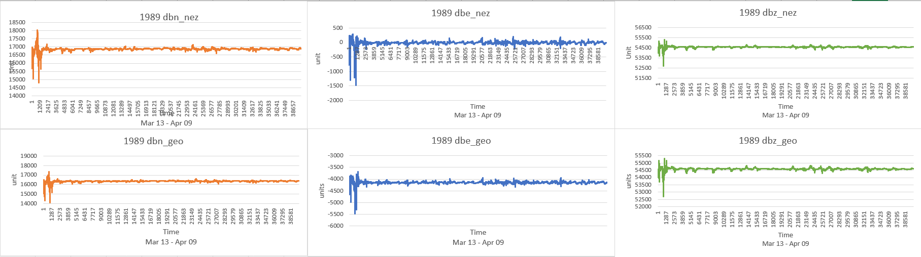
SuperMAG (Generated by Excel Chart)
Found out the dB/dt is indeed variate during the time period where hazard occurred. Both magnetic field variation in a local coordinate system (nez) and in a geographic coordinate system(geo) have similar reaction. Thinking it is possible to take these parameter into our model.
(The hazard occurred Mar 13 1989, the data of this chart starts from Mar 13, 00:00:00 to Apr 09, 23:59:00 )

Slide 7
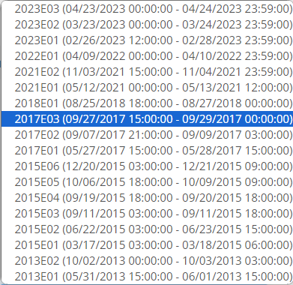
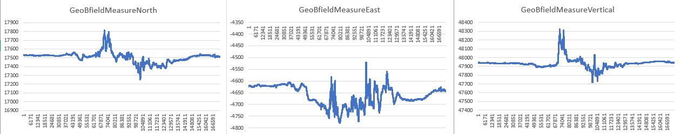
NERC data
The dataset in NERC is also incomplete (only 2013~2023)
No info of hazard

Slide 8
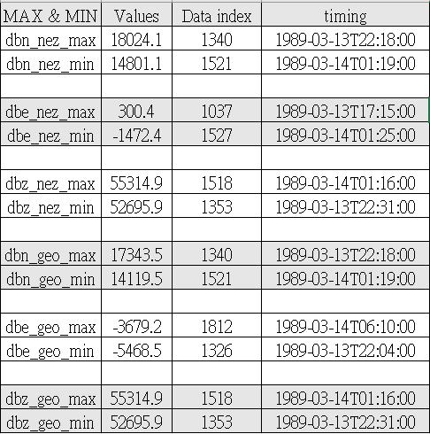
Extreme value timing
SuperMAG 1989 Mar. - Apr
(Excel chart)
In 6 sets of dB/dt values
The extreme value occurred in average
“3 hours” from maximum to minimum.

Slide 9
Problem:
Make sure it is the forecasting time between detecting abnormal dB/dt in the station and hazard occurring in powergrid we have to figure out.
The Power-grid data regarding hazard do not have exact timing, only month and dates.
The “Voltages measured on long grounded electrically conducting lines in North America during several magnetic storms' 'have only the data from 1891-1940. But the superMAG data is from 1980. So maybe we can not use this data.
Next Steps:
Look into NERC dataset and try integrating into our current analysis
Figure out the interaction between CME and GIC for prediction analysis.
Detect and analyze the interaction between SEP, GCRs, EUV and ionosphere in advance.
Try to figure out current forecasting ability

Slide 10
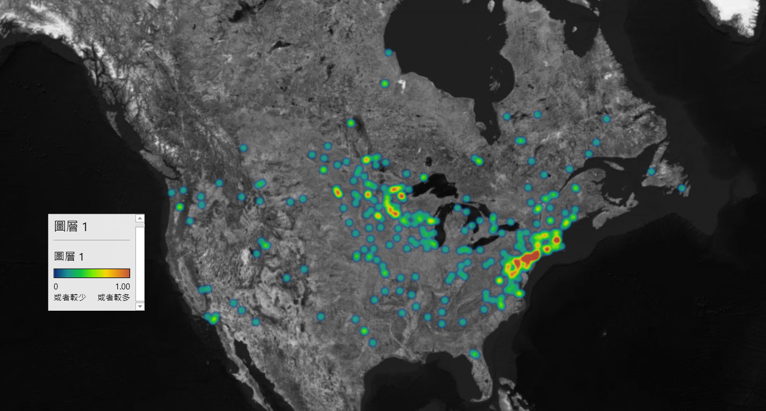
Density of power-grid incidences all time
Layer
Data Source: North America power-grid anamolies, x NERC 1940 A.D.- 2000 A.D.

Slide 11
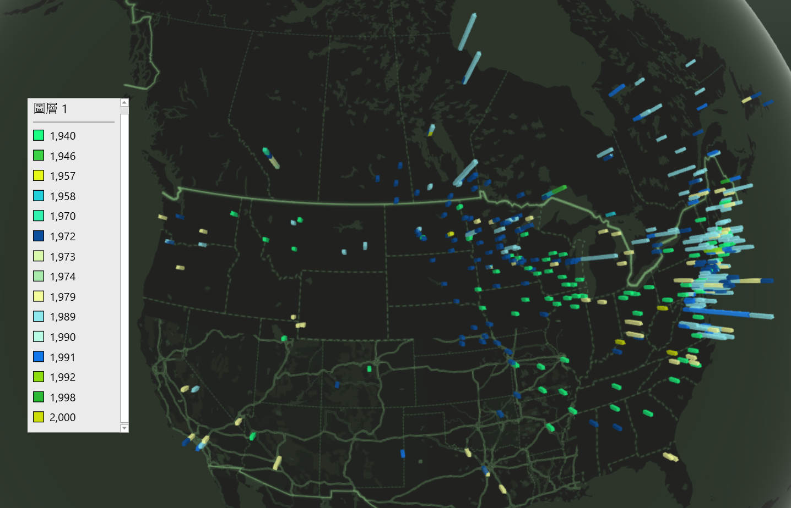
Density of power-grid incidences by year (Histogram)
Year
Data source: SuperMAG, x NERC 1940 A.D.- 2000 A.D.

Slide 12
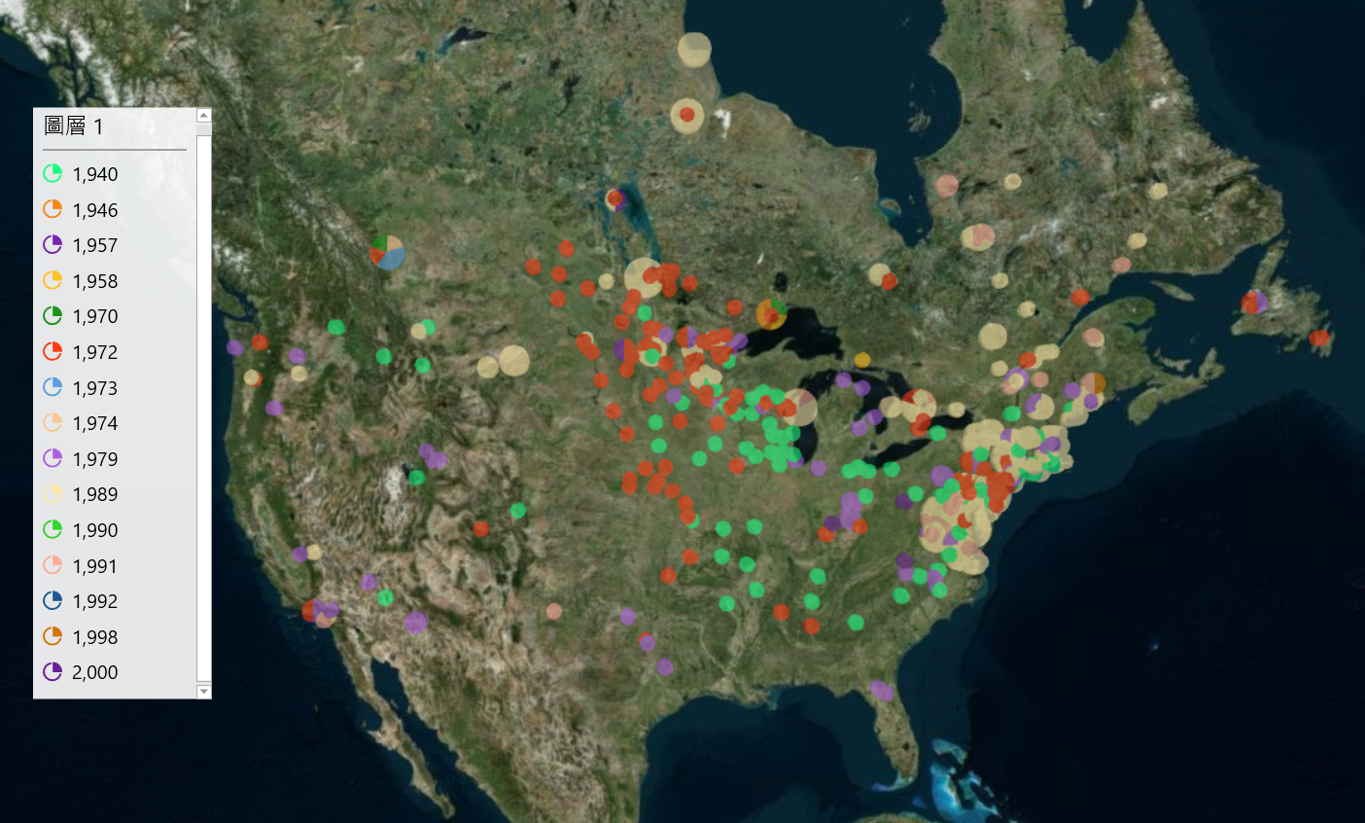
Density of power-grid incidences by year (Pie chart)
Year
I think we can focus on dataset from East coast for prediction prototype
Next Step: Try integrate a dataset with timeline for machine learning

Slide 13
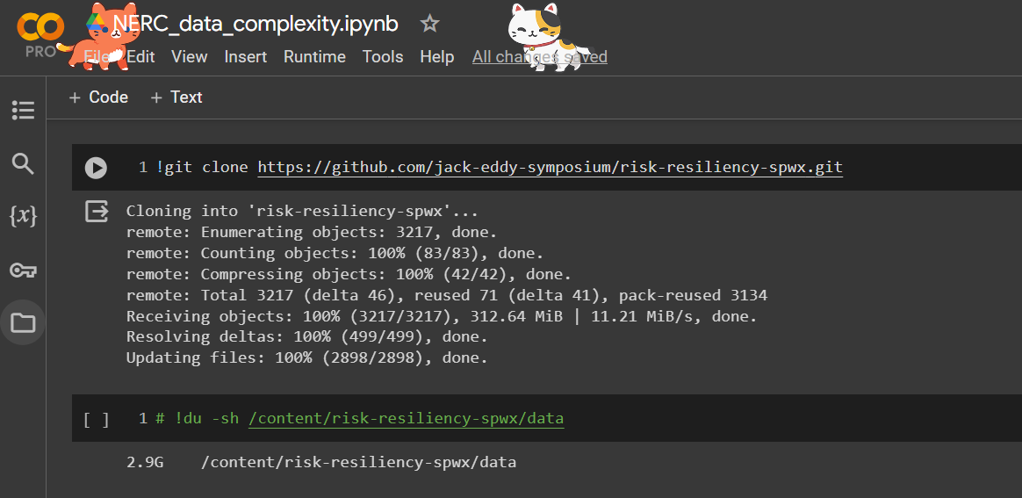
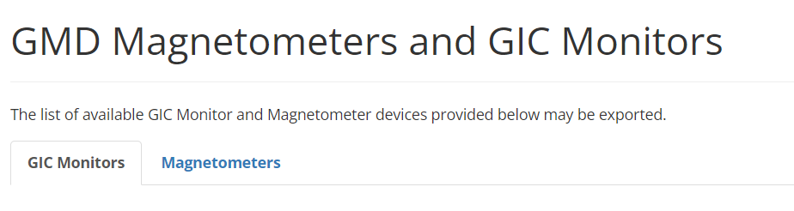
Progress Report
NERC:
Still need some time looking into the GIC raw data processing (some errors when running code)
I use monitor dataset for visualization this time. Not sure about the purpose of this dataset, but I am certain it lacks a lot of info

Slide 14
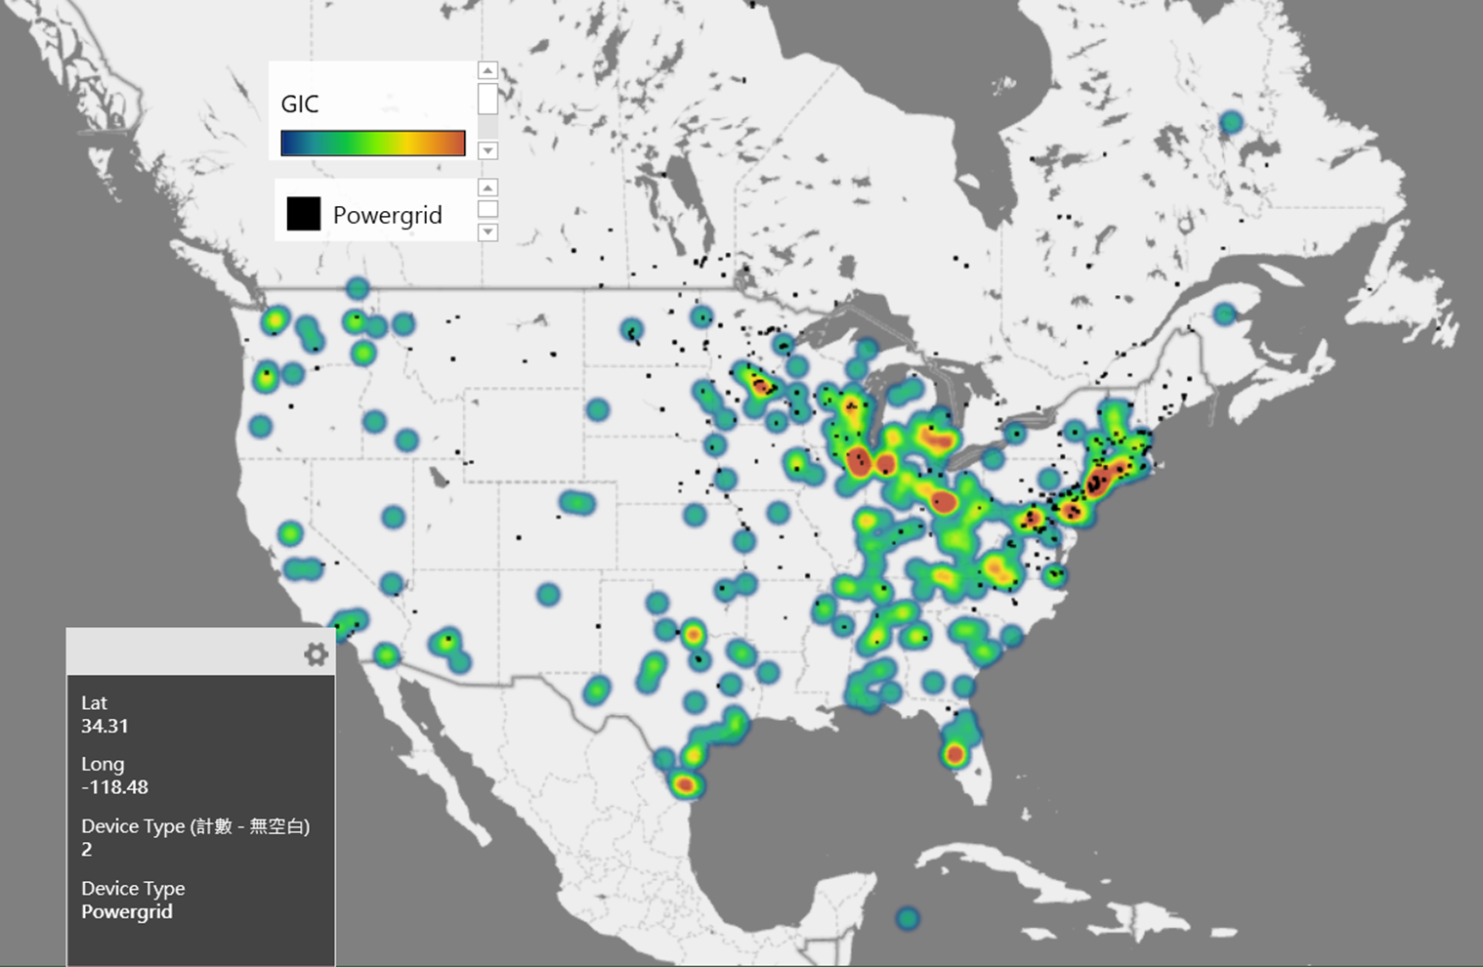

Slide 15
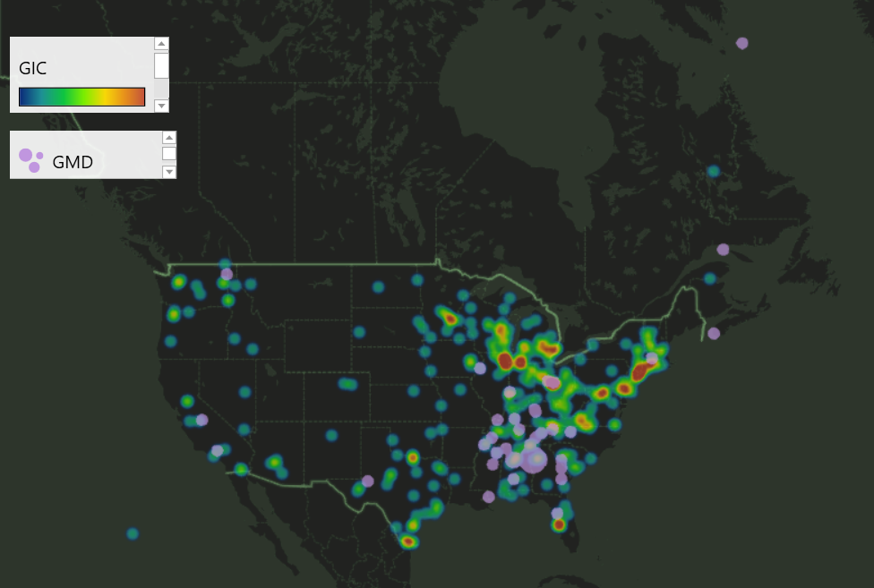

Slide 16
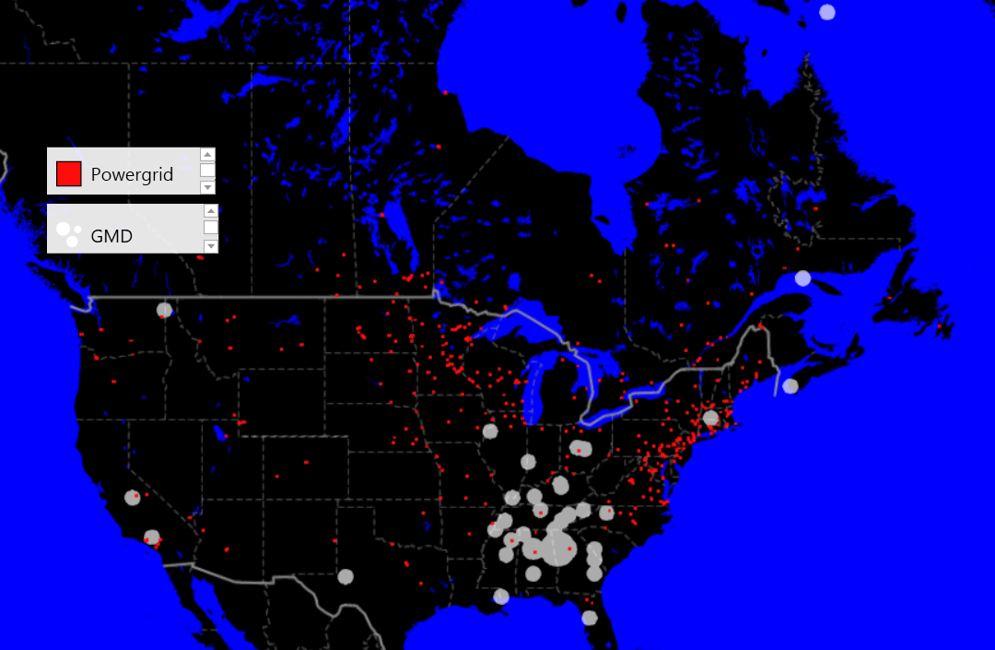

Slide 17
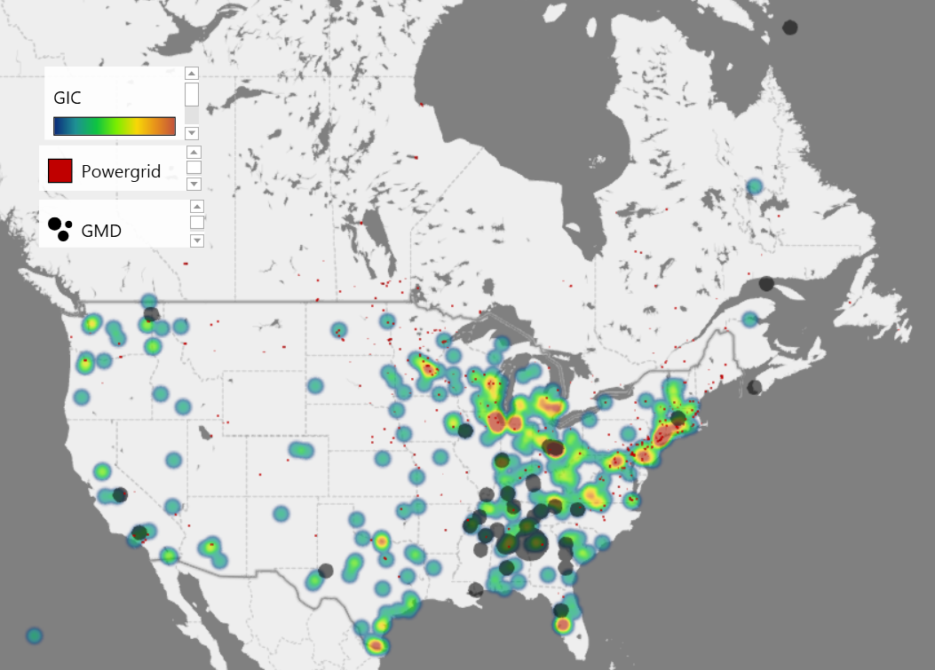

Slide 18
Next Step
Problem
Look deeper into and try utilizing the data processing code (Ryan’s Github)
Generate a map with more accurate information ( Time matching between datasets)
Integrate different dataset for machine learning prototype model doing prediction
Have not found out a method to integrate time and coordinate of NERC data

Slide 19
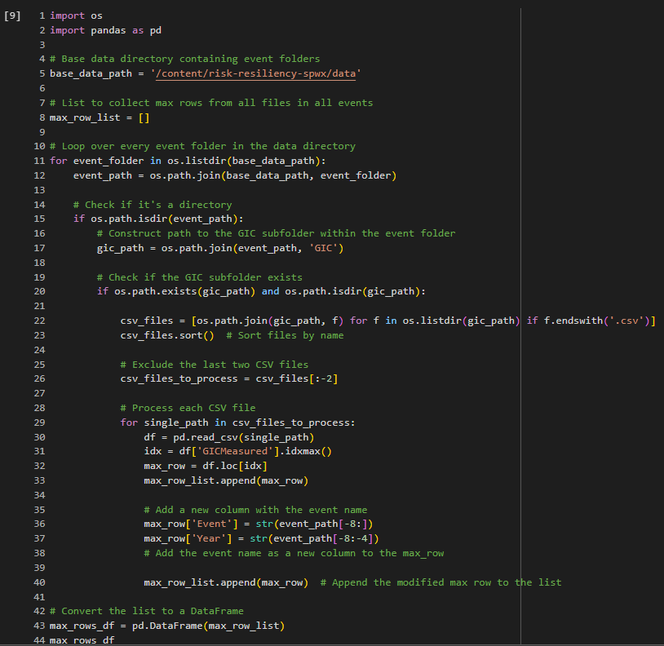
2024. Feb. 12
Extreme Value Analysis
Process:
Using python process the NERC GIC data.
Extract parameters:
Coordinates
Timelines
GICmeasure max_values
Event file_names
Event time (By year)
Visualization:
Combining “NERC GIC data” and “Database of power grid anomalies” on real map

Slide 20
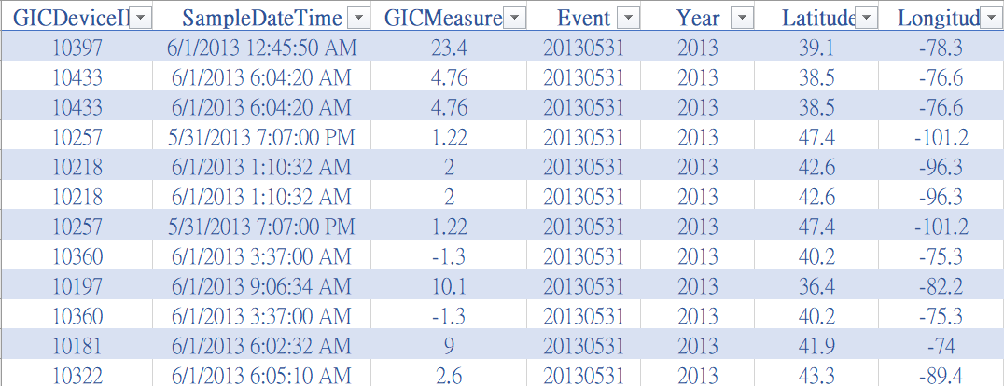
Format of “NERC GIC data”

Slide 21
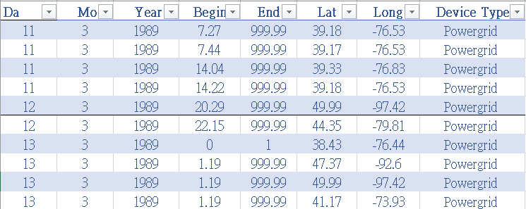
Format of “Database of power grid anomalies”

Slide 22
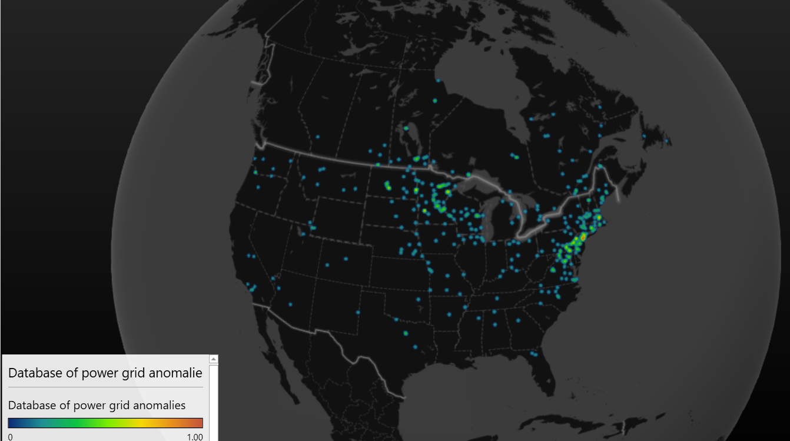
Visualizing “database of power grid anomalies” and “NERC GIC data” max_value

Slide 23
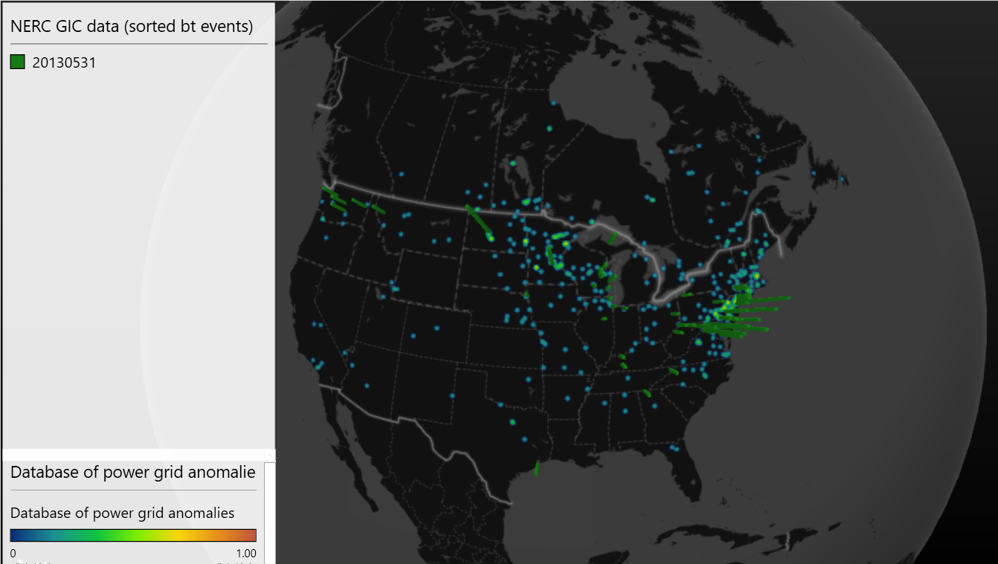

Slide 24
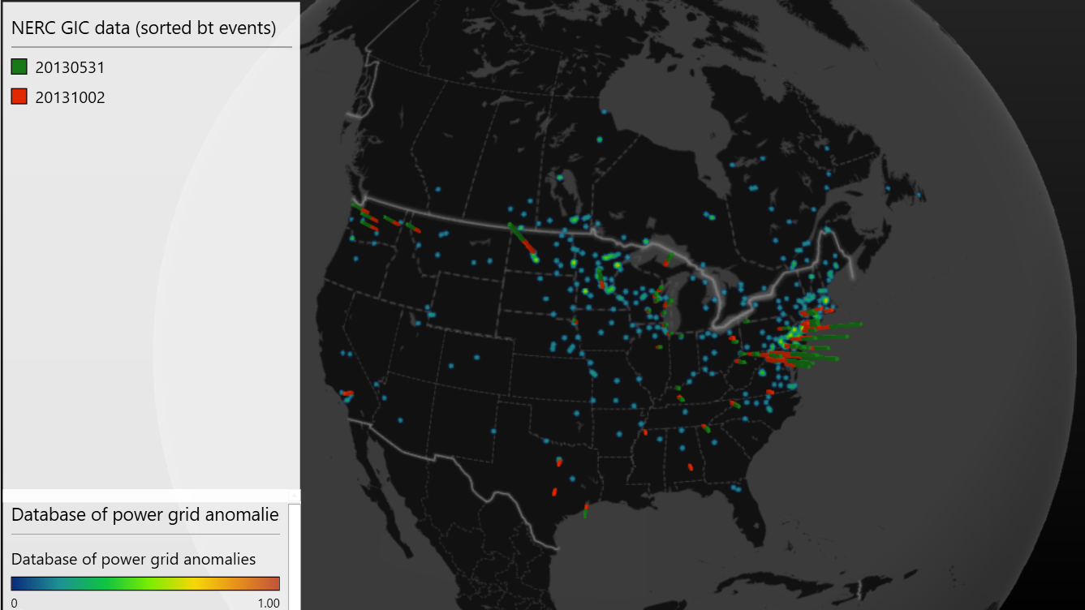

Slide 25
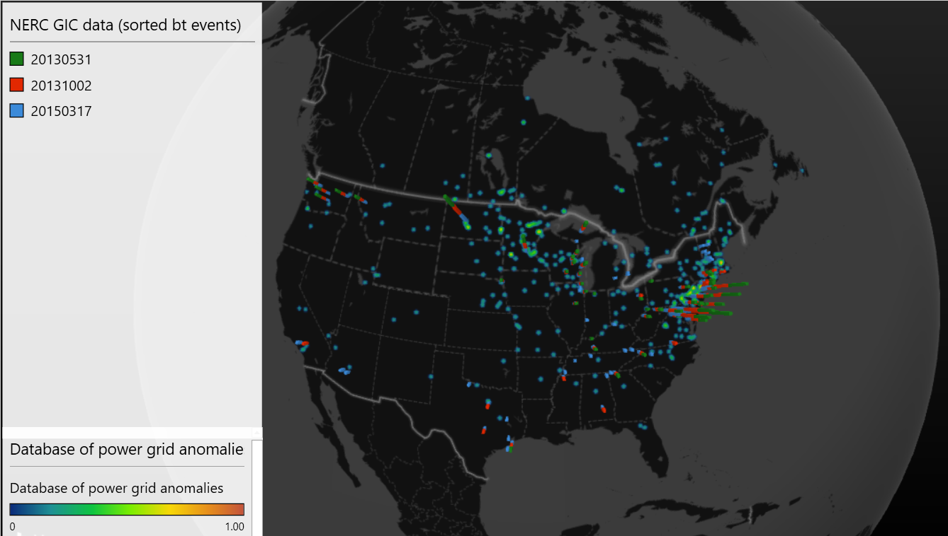

Slide 26
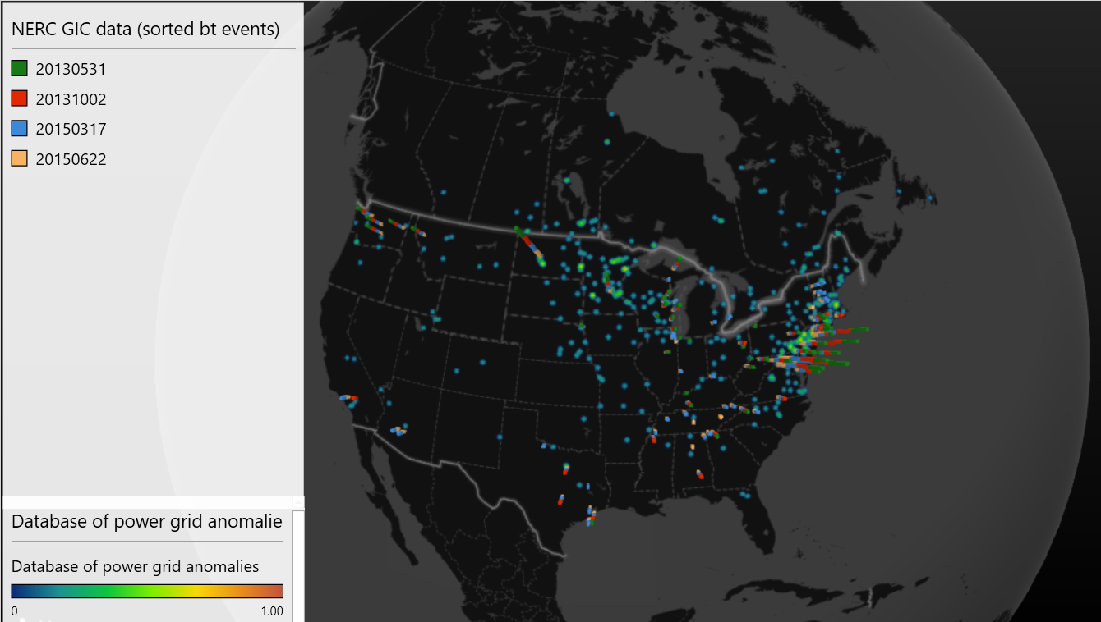

Slide 27
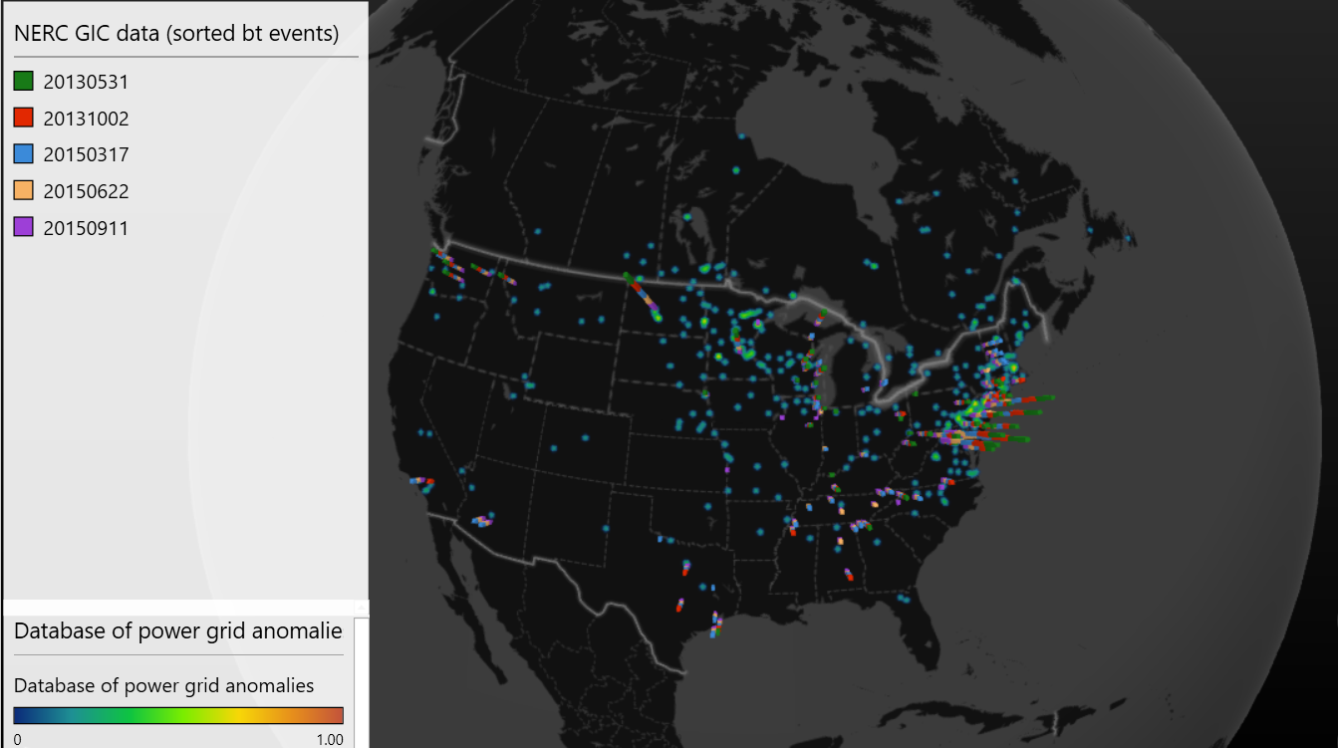

Slide 28
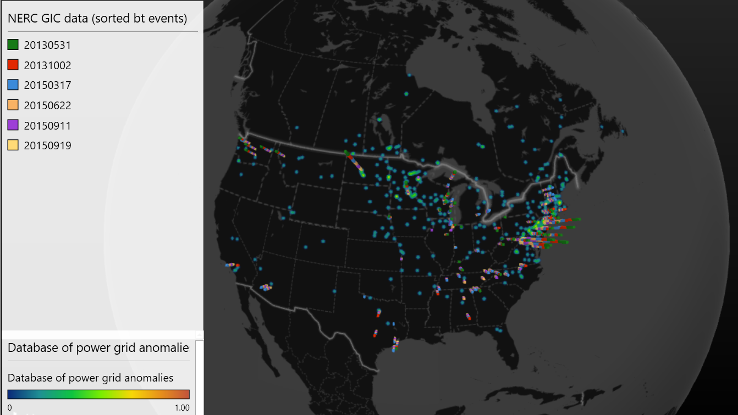

Slide 29
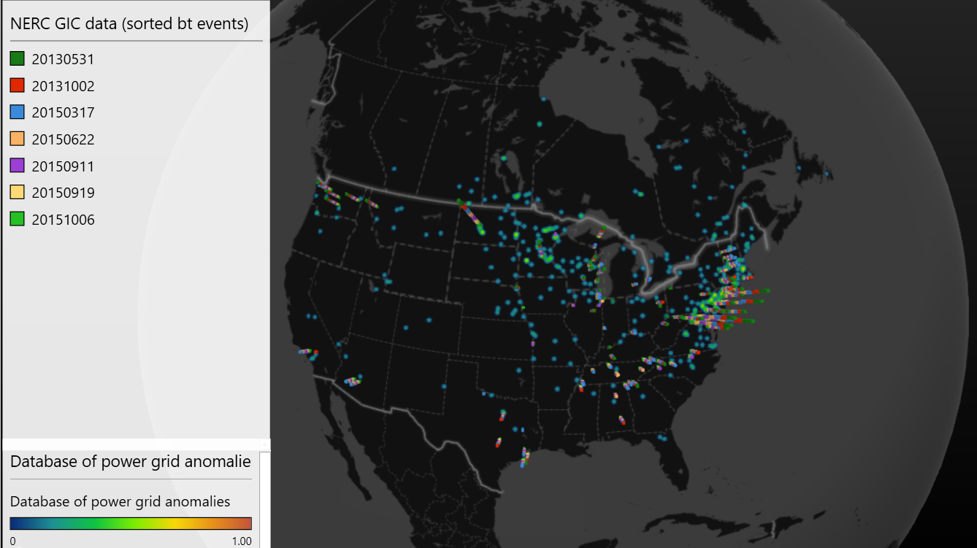

Slide 30
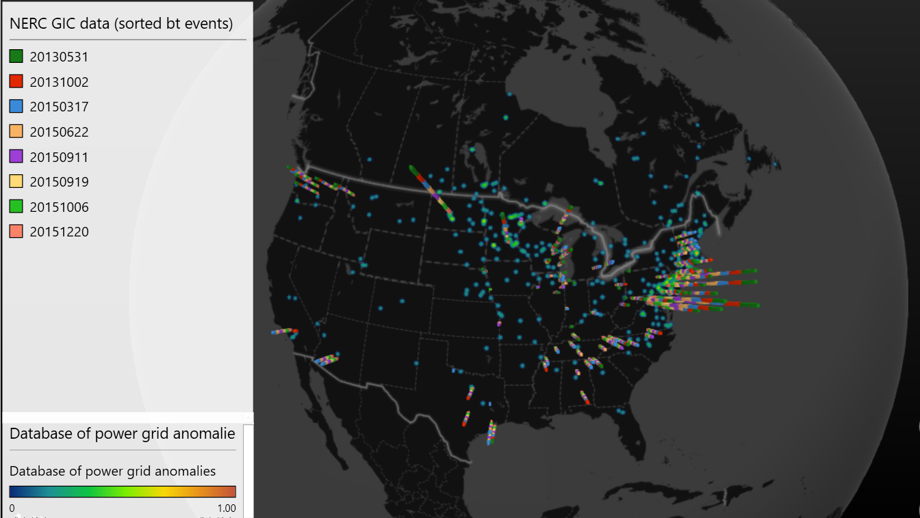

Slide 31
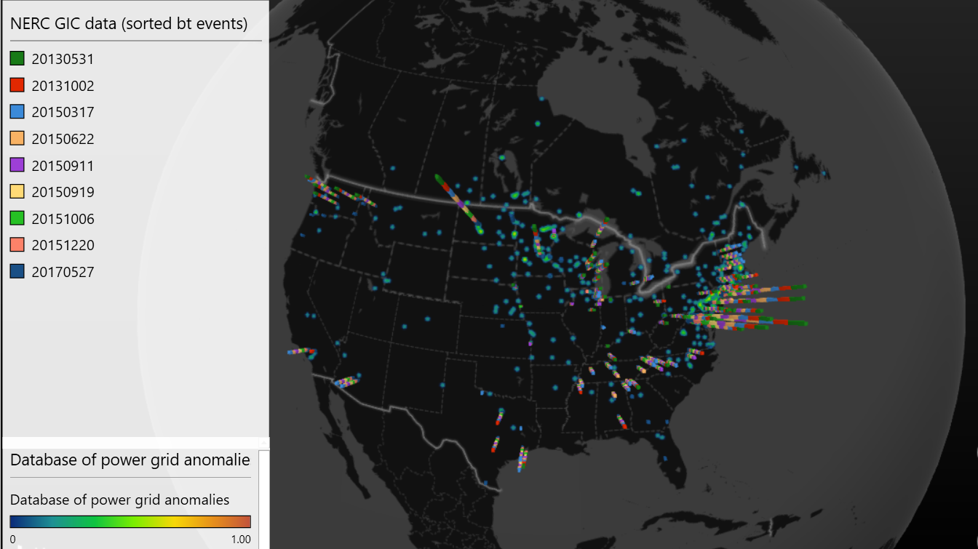

Slide 32
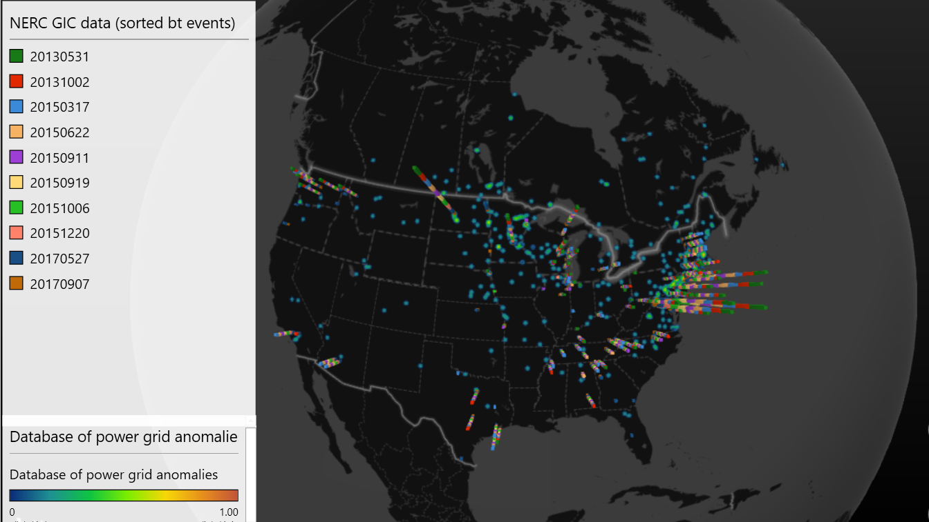

Slide 33
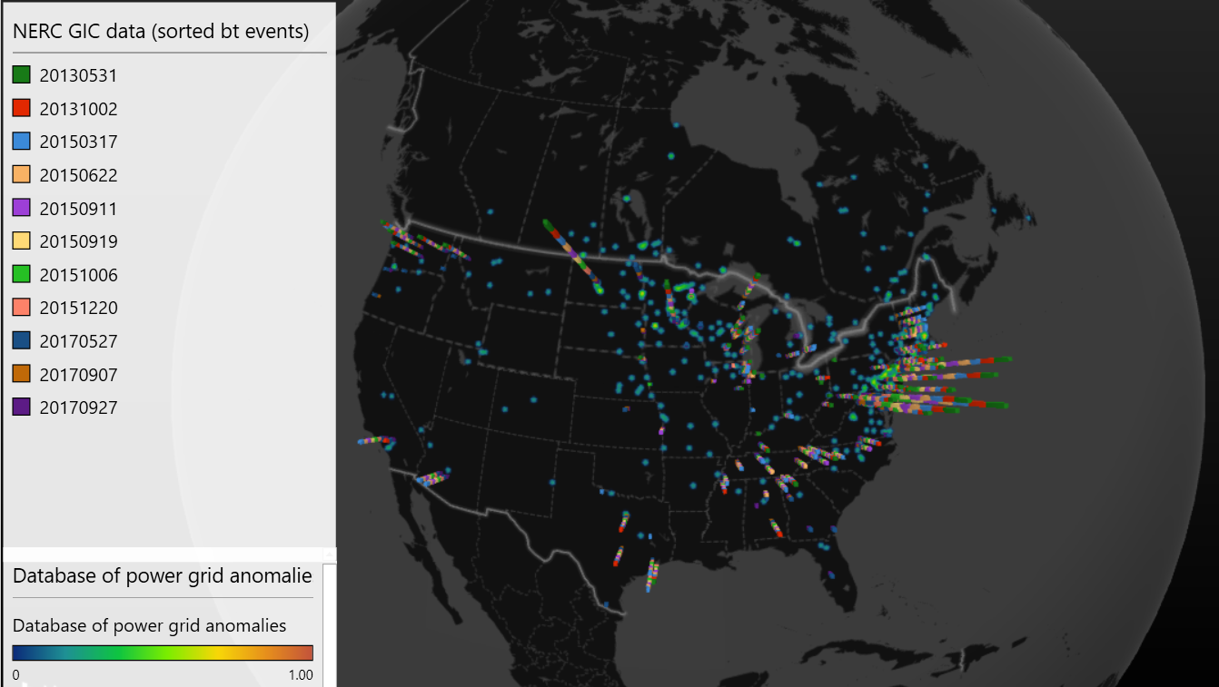

Slide 34
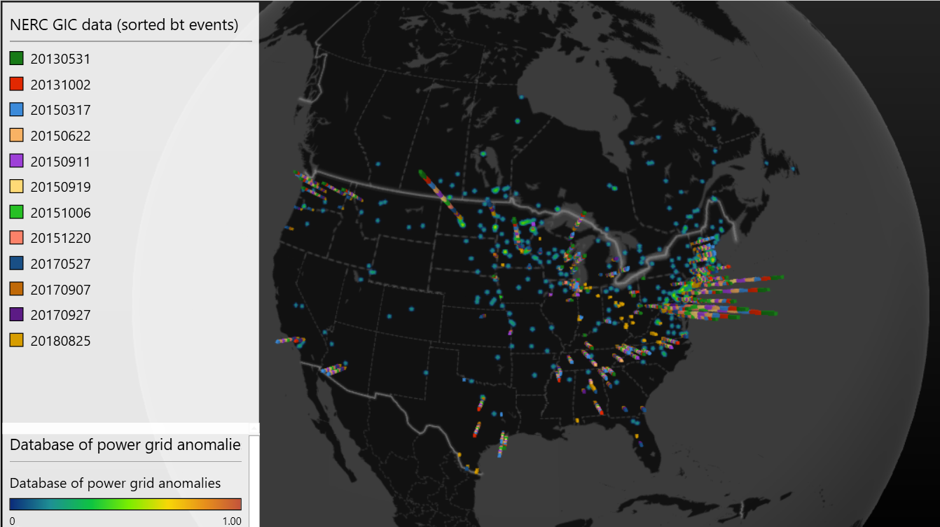

Slide 35
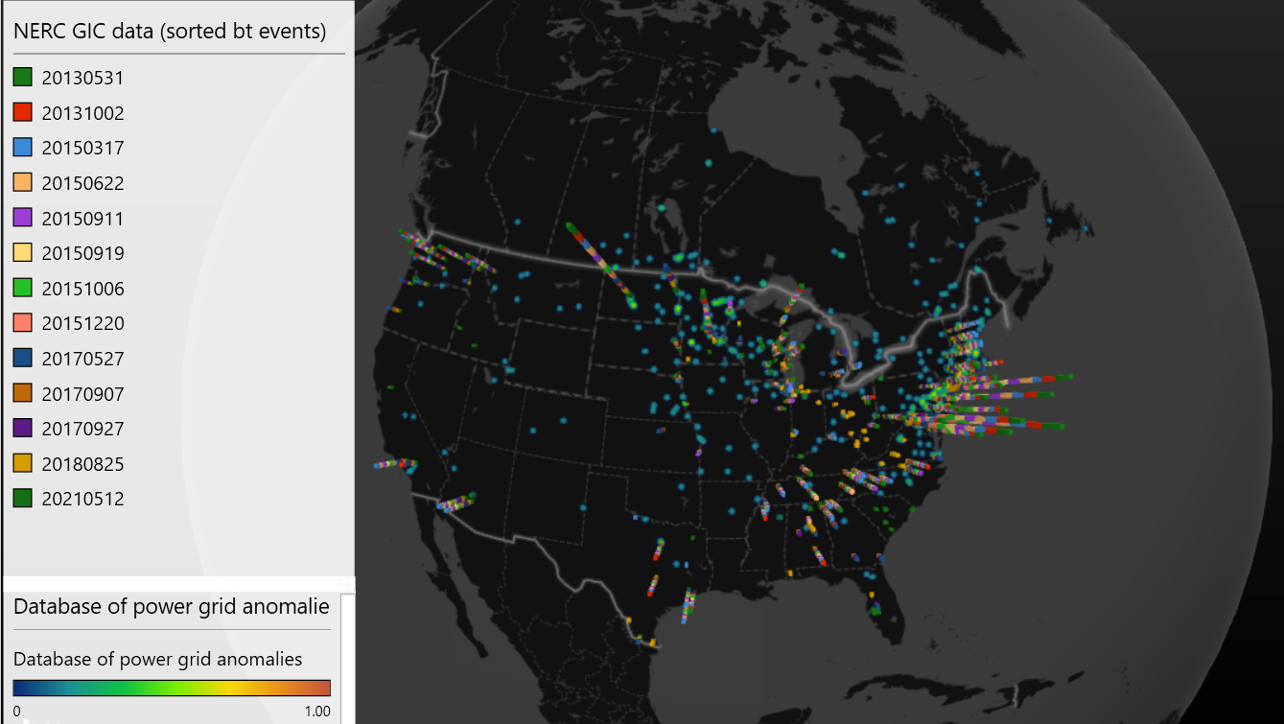

Slide 36
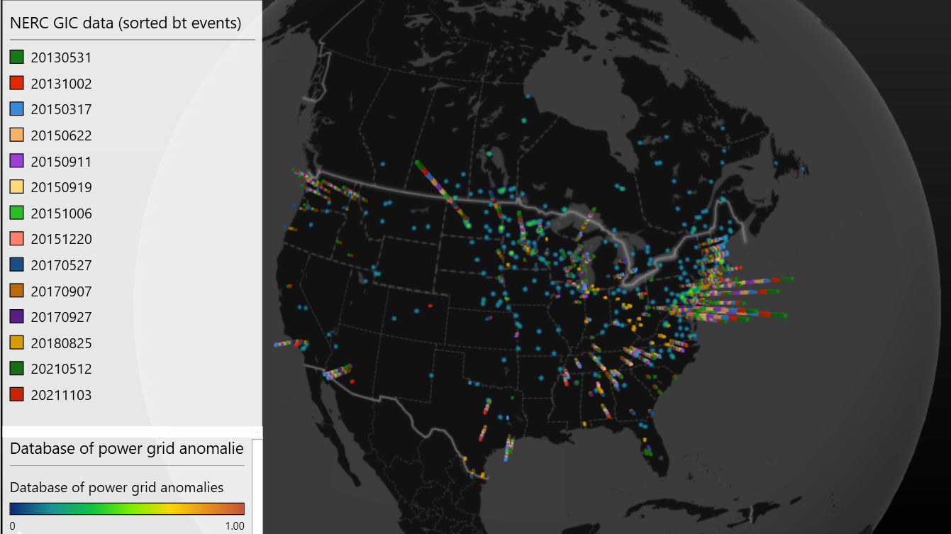

Slide 37
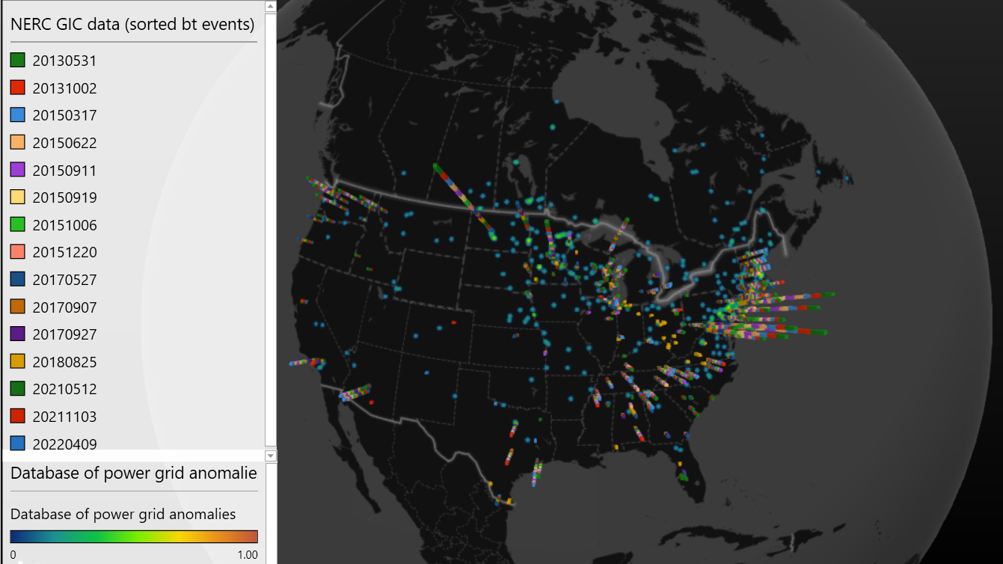

Slide 38
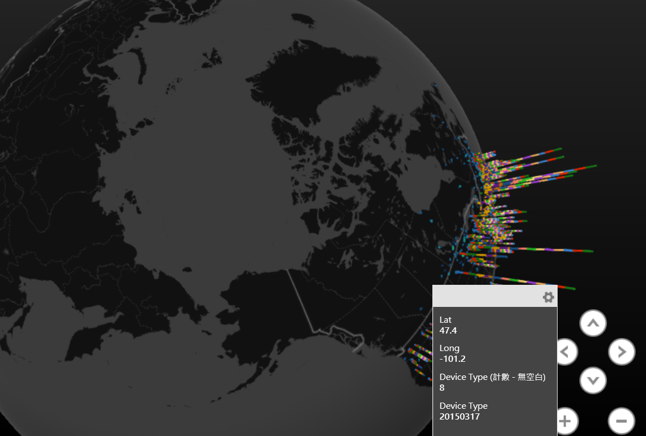
Lat: 47.4
Long: -101.2

Slide 39
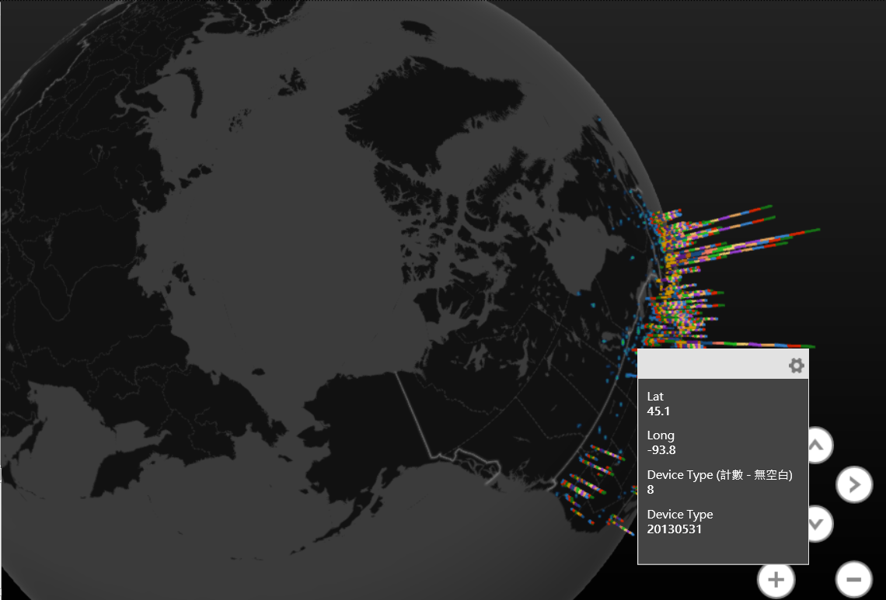
Lat: 45.1
Long: -93.8

Slide 40
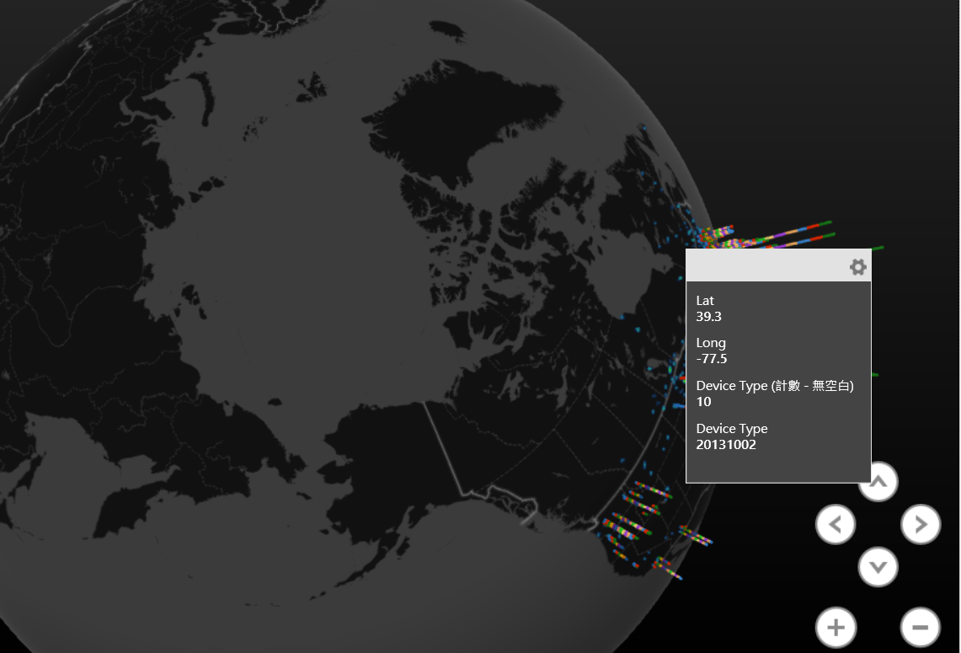
Lat: 45.1
Long: -93.8
Lat: 39.3
Long: -77.5

Slide 41
Discussion and Notes
Next Step:
Using those three locations to build prediction model as a prototype ?
Try integrating the data with explicit timeline and parameters for ML ?
Suggestions:
Extreme value : Generalized Pareto Distribution
GICmeasure extreme negative number
Estimate how large the event
Integrate superMAG and SOLAR wind
Sunpy package !pip install sunpy[all]
ClimtextRemes vs pyextremes
URL for climextremes:
lbl-cascade / climextremes-dev — Bitbucket

Slide 42
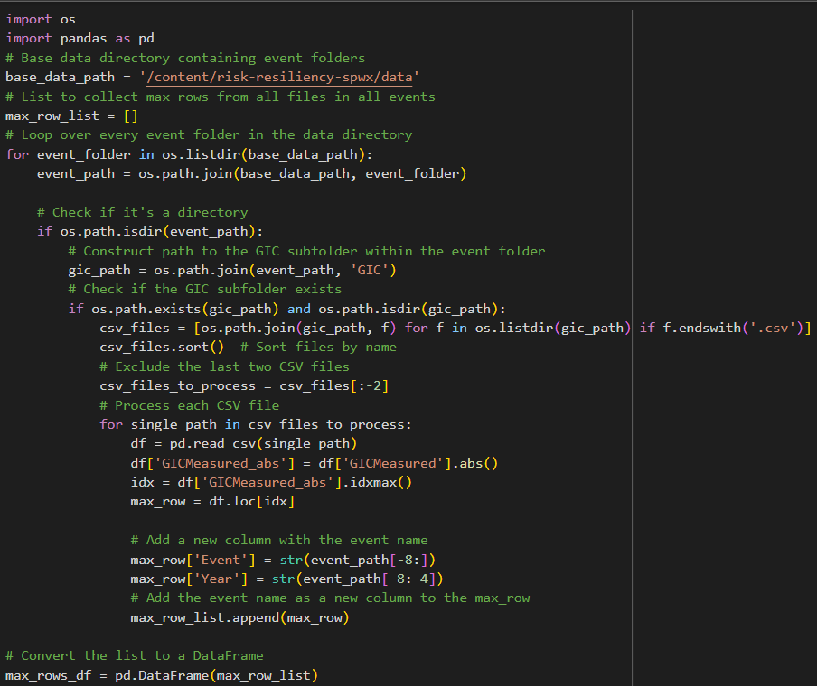
2024. Feb. 12
Extreme Value Analysis
Process:
Using python process the NERC GIC data.
Extract parameters:
Coordinates
Timelines
GICmeasure max_values
Event file_names
Event time (By year)
Visualization:
Combining “NERC GIC data” and “Database of power grid anomalies” on real map

Slide 43
Format of “Database of power grid anomalies”

Slide 44
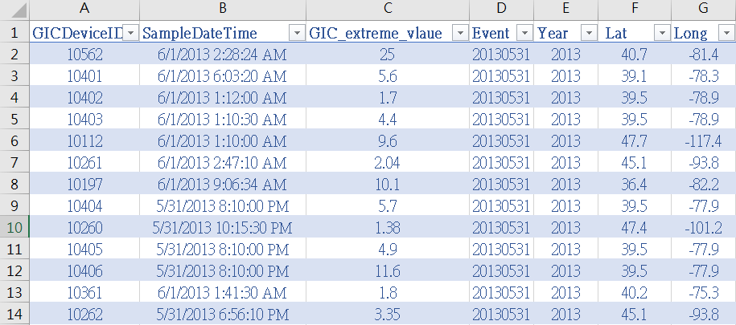
Format of “NERC GIC data”

Slide 45
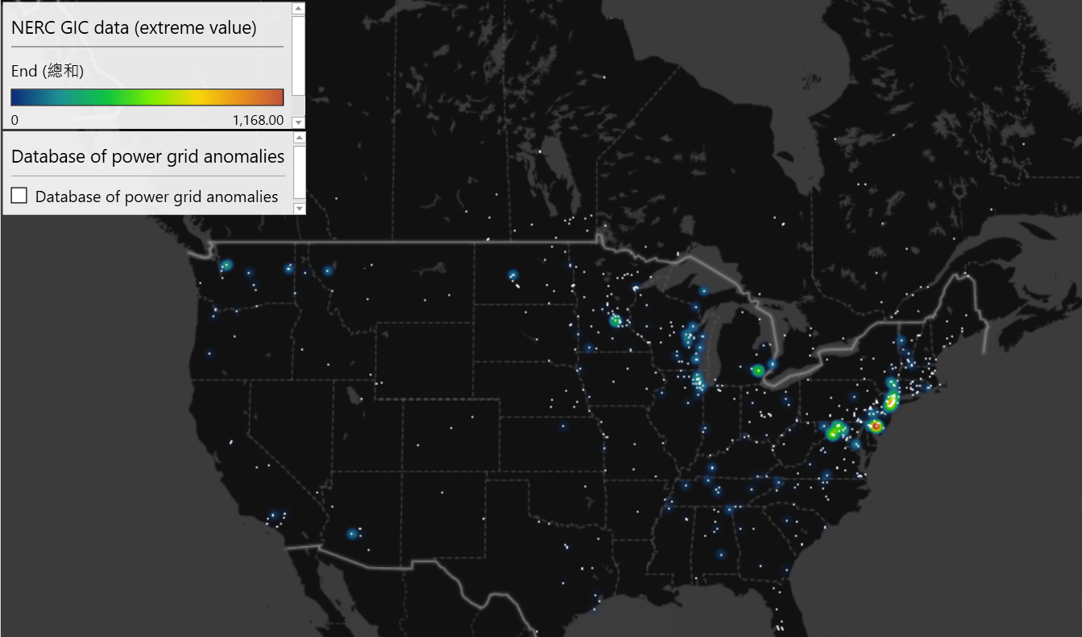

Slide 46
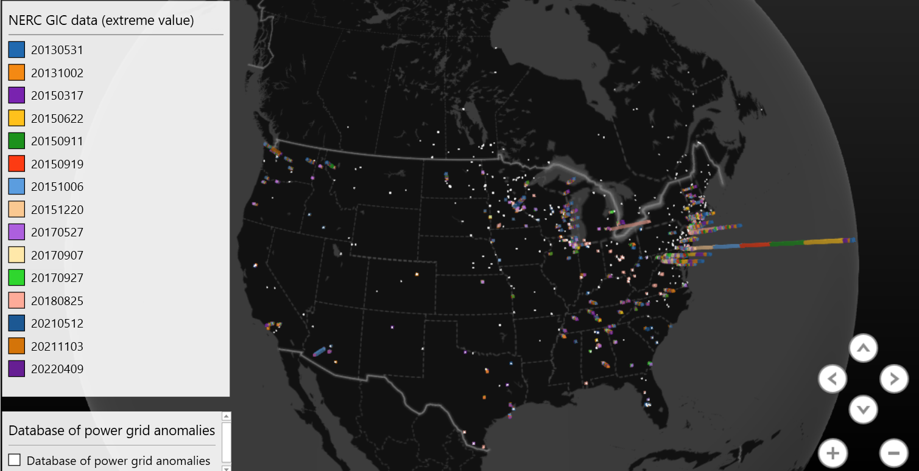

Slide 47
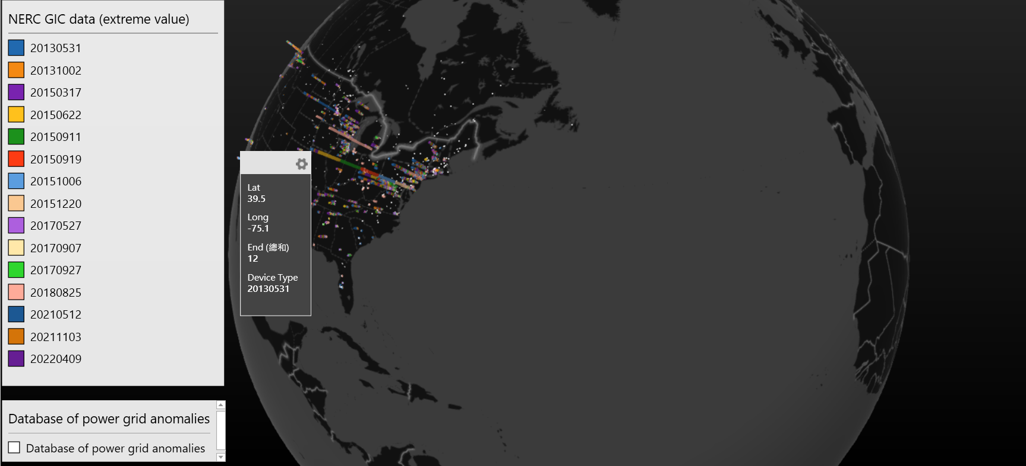

Slide 48
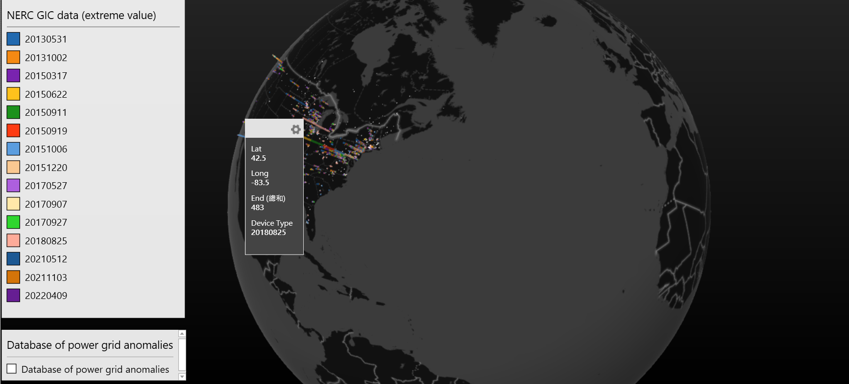

Slide 49
Progress Report
Visualization
Correct the output data format on the map (showcase the locations of different events without stacking the GIC extreme value)
It is a bit difficult to show all the events on one single image since the sensors location are overlapping each others.
Data integration
Share the NERC GIC extreme value processed dataset file with Machine Learning team for prediction model variables (Including time, coordinates).

Slide 50
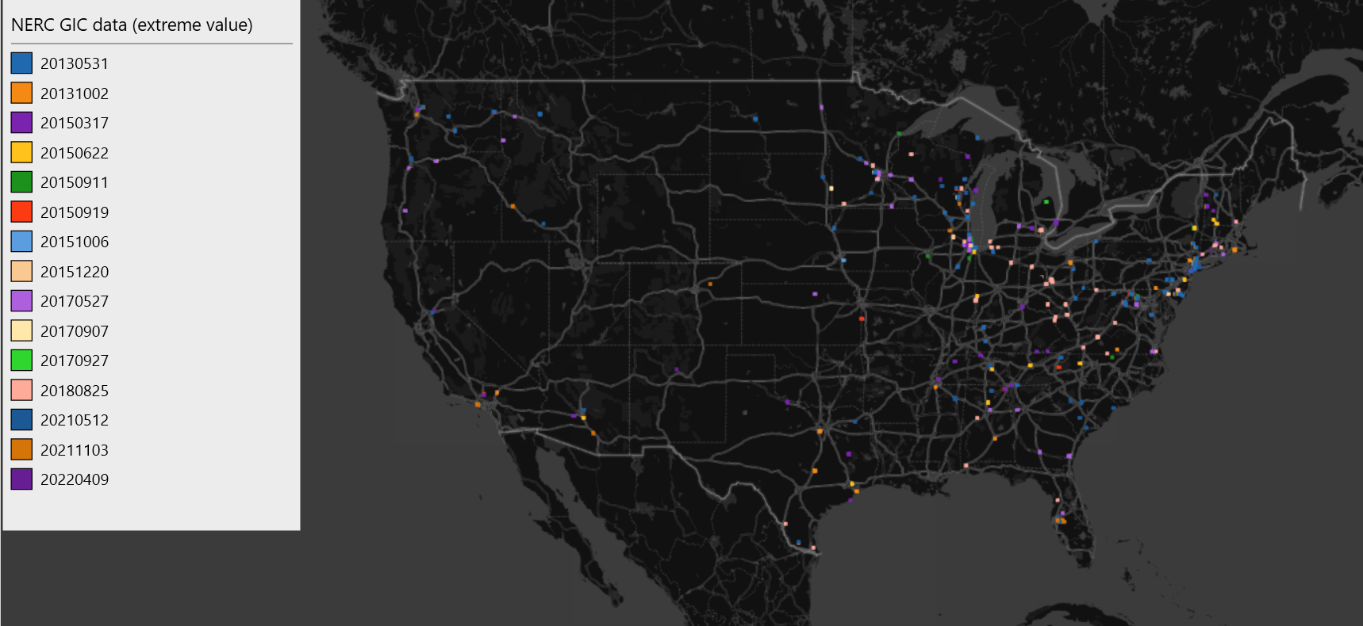

Slide 51
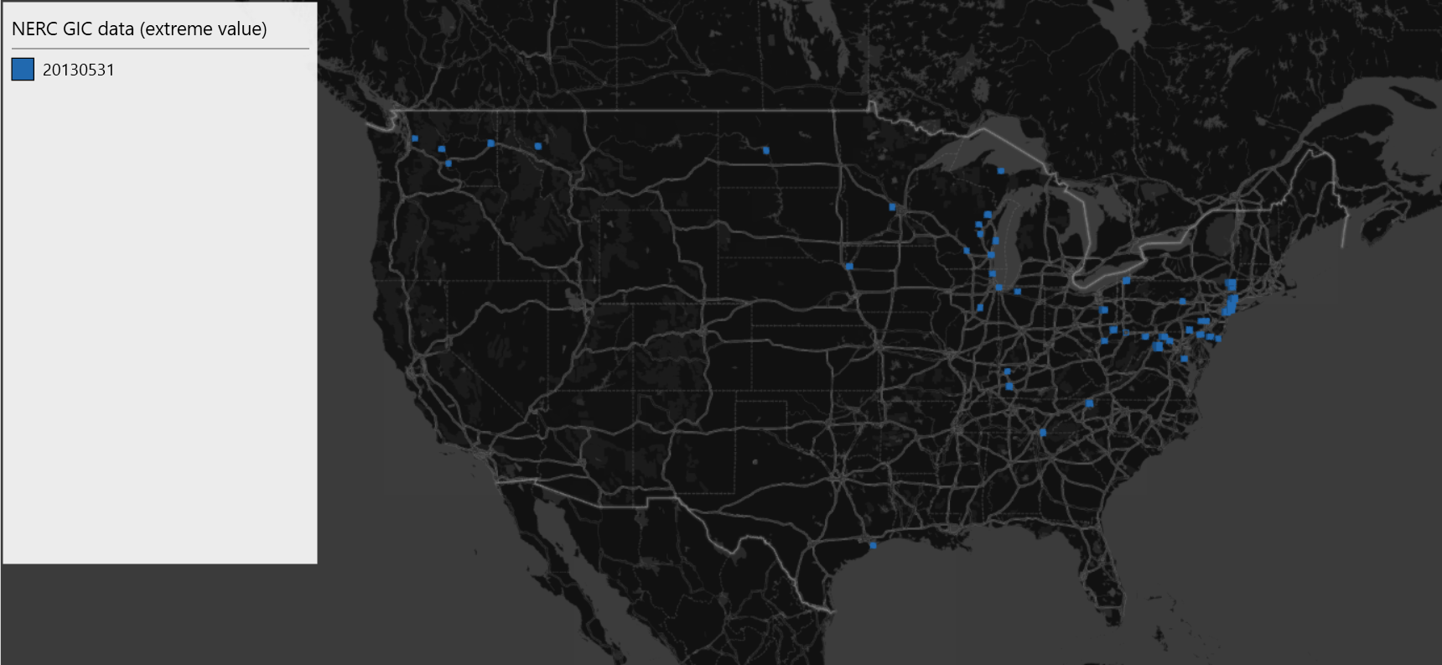

Slide 52
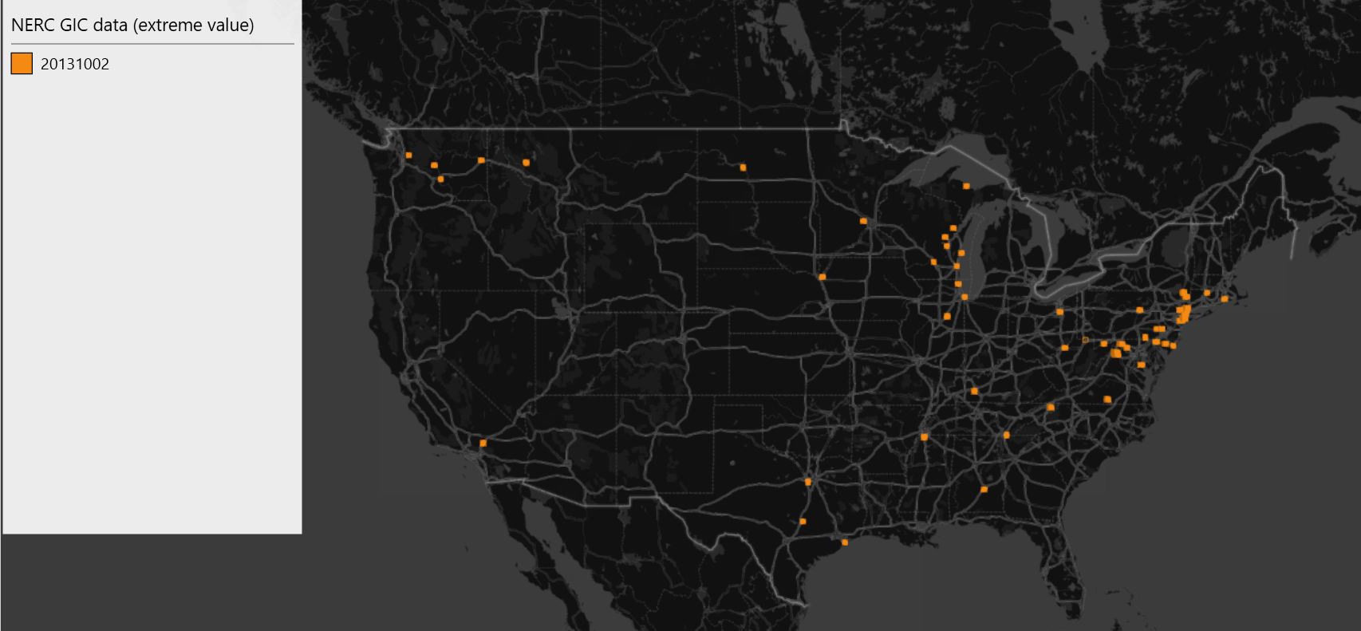

Slide 53
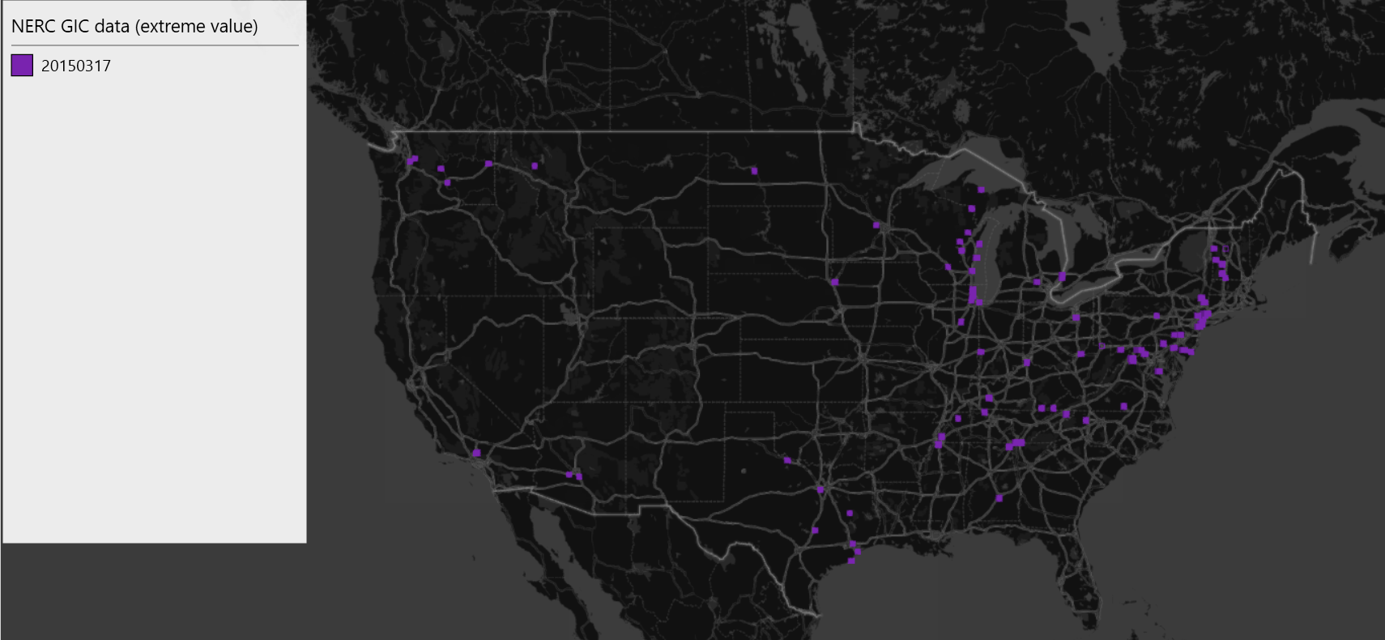

Slide 54
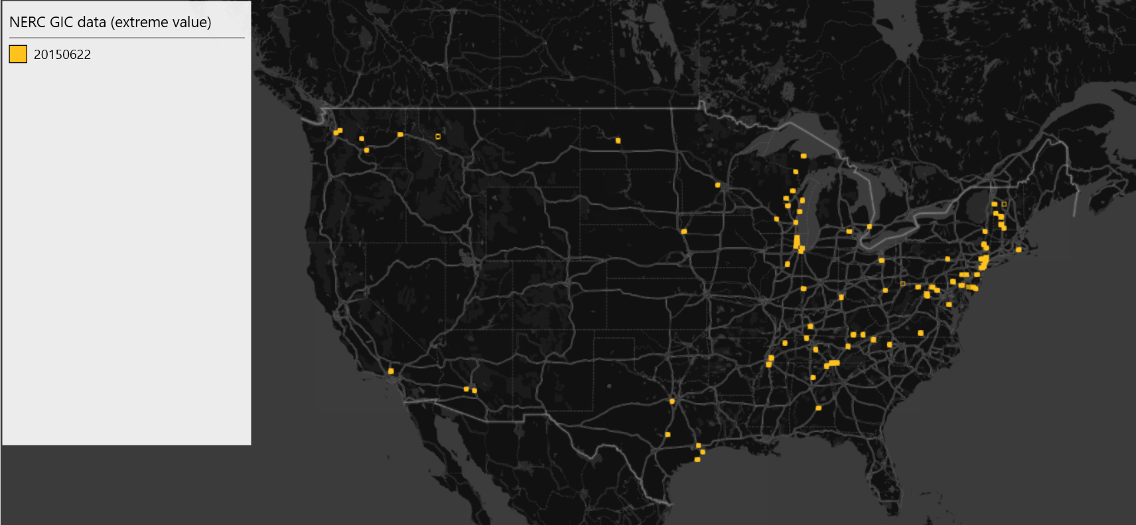

Slide 55
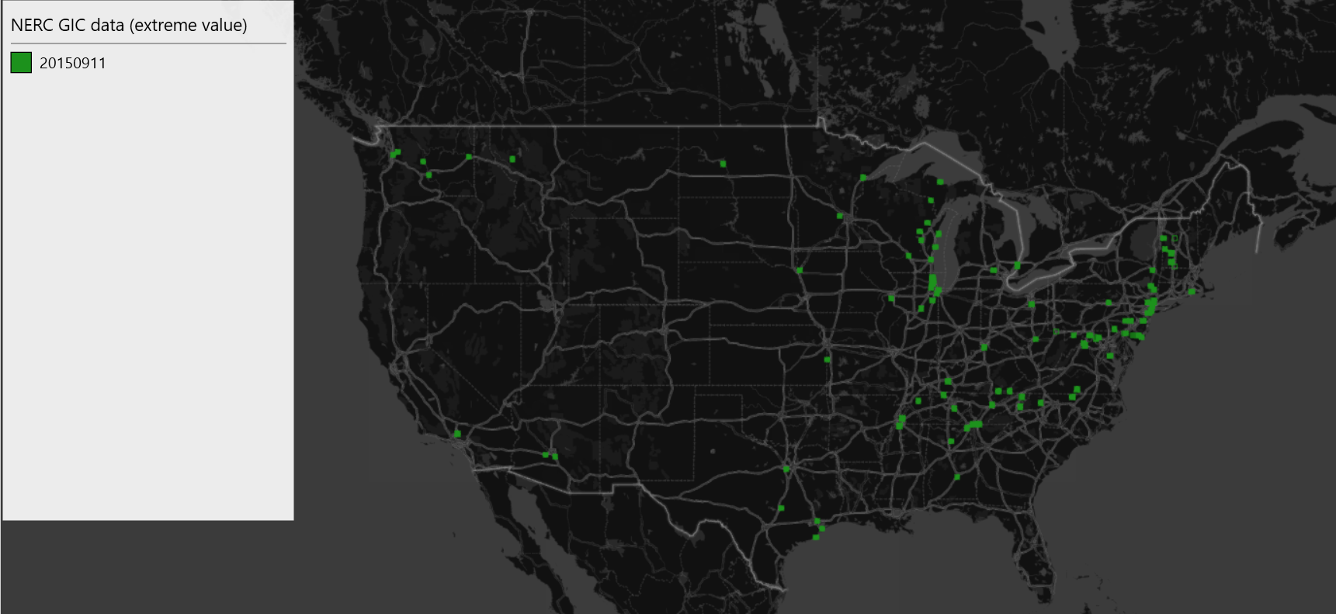

Slide 56


Slide 57


Slide 58


Slide 59


Slide 60


Slide 61


Slide 62


Slide 63


Slide 64


Slide 65


Slide 66

20130531

Slide 67

20131002

Slide 68

20150317

Slide 69

20150622

Slide 70

20150911

Slide 71

20150919

Slide 72

20151006

Slide 73

20151220

Slide 74

20170527

Slide 75

20170907

Slide 76

20170927

Slide 77

20180825

Slide 78

20210512

Slide 79

20211103

Slide 80

20220409

Slide 81

Sum of every years

Slide 82
Extreme Value Analysis Progress Report
Visualization
Using Heatmap to specify GIC extreme value ( colors represent values )
Tried made the scale of spectrum the same in every events ( it made some events inconspicuous)
Will try make it a video to demonstrate at the final presentation on Mar. 12
White dots - locations of Database of power grid anomalies
Ryan and other’s comments ?
Sorry I have a clinical appointment for vaccination on 11am, will try join you if possible
Thanks for my teammate for showing the slides —-- Chris

Slide 83
University of Washington ENGINE capstone
Topic: “Machine learning for predicting space weather hazard “ — NASA JPL
Extreme Value Analysis (sub-team) visualization progress report
This report is regarding visualizing Geomagnetic Induced Current (GIC) extreme measured values on a real world map
We extracted the extreme values from every stations(location) from every events
An Event means during specific times there are abnormal GIC values
Features
Display the GIC extreme values event by event (2013~2023)
Using Heatmap to specify GIC extreme values ( colors represent values )
Tried making the scale of spectrum the same in every events ( it made some events inconspicuous, E.g. near Seattle and San Diego)
White dots - locations of Database of power grid anomalies ( 1940 A.D.~1980 A.D.)

Slide 84

May. 31. 2013
(amp)
amp

Slide 85

Oct. 2. 2013

Slide 86

March. 17. 2015

Slide 87

Jun. 22. 2015

Slide 88

Sep. 11. 2015

Slide 89

Sep. 19. 2015

Slide 90

Oct. 6. 2015

Slide 91

Dec. 20. 2015

Slide 92

May. 27. 2017

Slide 93

Sep. 7. 2017

Slide 94

Sep. 27. 2017

Slide 95

Aug. 25. 2018

Slide 96

May. 12. 2021

Slide 97

Nov. 3. 2021

Slide 98

Apr. 9. 2022

Slide 99

General GIC extreme values from every events (2013 ~ 2022)

Slide 100
References and Tools
NERC: https://eroportal.nerc.net/
Ryan’s Github: https://github.com/jack-eddy-symposium/risk-resiliency-spwx/tree/main/data/event_20130531/GIC
Python
Excel

Slide 101
Thank you

Slide 102


Traditionally Extreme Value Types recognizes two types of extreme values:
Block maxima (minima) (BM)
Peaks over threshold (POT)
A third approach the so-called r-largest order statistics represents a compromise between the block maxima and peak over threshold approach.

Slide 103

POT

Slide 104
Network Analysis
Objective: To quantify the magnitude and impact of Geomagnetically Induced Currents (GIC) on U.S power grid.
Approach:
Use wavelet decomposition on magnetic field & GIC data to determine significant changes
Cross -correlation with U.S power grid data
Perhaps, need estimation of ground conductivity
Datasets:
SuperMAG Data - (ground Geomagnetic perturbations)
NERC - GICs (starting from 2013)
U.S Power Grid Data (voltage)
U.S Power Transmission Line Overlay
https://resilience.climate.gov/datasets/fedmaps::u-s-electric-power-transmission-lines/about
U.S. Test System with High Spatial and Temporal Resolution for Renewable Integration Studies]
(https://zenodo.org/record/4538590)
synthetic grids: https://arpa-e.energy.gov/technologies/programs/grid-data

Slide 105


One original sample from NERC

Slide 106

Wavelet Transform

Slide 107


Using MATLAB

Slide 108


Slide 109


Slide 110


Step 1: Data preprocessing is aligned with the time scale
This step involves loading the raw GIC data, aligning all data onto the same time scale. This may require resampling.
Step 2: Perform the Haar wavelet transform
After data alignment, a Haar discrete wavelet transform is performed for each data sequence.
Step 3: Select a specific level of data and draw a heat map
Select specific hierarchical data from the Haar wavelet transform results, and then use these data to draw a heat map.

Slide 111




Resampled dataset

Slide 112


Wavelet transform coefficients
Coeff[0]
Coeff[1]

Slide 113

Heap Map
Coeff[0]

Slide 114

Coeff[1]

Slide 115



Slide 116

Event: 20130531

Slide 117

Event: 20130531

Slide 118

Event: 20131002

Slide 119

Event: 20131002 by Latitude

Slide 120

Event: 20131002

Slide 121

Auroral Ejection Index Event: 20131002

Slide 122
Event: 20131002
Auroral Ejection
Index
Wavelet Decomposition
(Haar)

Slide 123


Slide 124


Slide 125
Machine Learning
Objective: Being able to predict/forecast GIC would be necessarily and plays important role in mitigation against the impact on the critical infrastructure. Our objective will focus on developing nowcast and predictive models for SuperMAG (dB/dt) and NERC GIC variables by exploring the most meaningful ML algorithms for these data.
Approach/Next Steps:
A few machine learning models/algorithms can be considered from the readings: Multi-variate Linear Regression, LSTM(with Attention)/GRU(depend on how large our dataset could possibly be), Transformer. But we can start with the simple model which is Multi-variate LR.
Consolidating the necessary datasets.
Clean up and impute data and get it ready for analyzing datasets.
Preprocessing dataset (can consider approach from the readings), feature engineering for datasets.
Datasets:
SuperMAG Data - (ground Geomagnetic perturbations)
NERC - GICs (starting from 2013)
OMNI - (solar wind and IMF)

Slide 126
Machine Learning
Limitation in prior researches:
Hard to apply accurate prediction on global scale: Due to the sparse samples from lower latitude area(MAGLAT ≤40°), researchers incorporating spherical harmonic formulation into computing global scale prediction, however, this method has limitation–it can’t resolve fluctuations shorter than a certain length scale.
Reliance in past data: LTSM rely on past data, which become a challenge when we are trying to make real-time prediction.
Missing values imputation: OMNI dataset exists huge data missing problem, which can be up to 25% across the full dataset. How to impute these data could significantly affect the performance of our model and the accuracy of our prediction.
Underpredicts the perturbation values: Current model will underestimate the perturbation values when the perturbations are large. It might be caused by two factors: 1. Model is trained predominantly during quiet times, thus, the results may potentially be biased toward more quiet time than active times, resulting in underprediction of perturbations. 2. Lack of “context” perturbation measurements. Can possibly be solved by incorporate a proxy for the state of the Earth's magnetosphere as an input to the model, however, capturing a summary of the magnetosphere, given changing stations across multiple MLT and MAGLAT, is nontrivial work.
Notes:
Using the Hugging Face for resolving machine learning problems related to underprediction of the models from readings.
Using 5mins data is more reliable.

Slide 127
Data for Forecasting dB/dt
Dataset: SuperMAG data, OMNI data
What do we get from each dataset:
SuperMAG data: ground magnetic perturbations in the geomagnetic field dbe, dbn.
OMNI data: Geocentric Solar Magnetospheric coordinates (Bx, By, Bz), solar wind speed (VSW), solar wind proton temperature (T), the clock angle of the IMF(θc), and finally the solar radio flux.

Slide 128

SuperMAG data of 28 days in Jan (All stations)

Slide 129

SuperMAG data of 28 days in Jan (station NEW)

Slide 130


OMNI data sample retrieval
Notes:
Ryan said last time we should use the 5 minutes cadence for OMNI dataset, however the SuperMAG data set is used in 1 min cadence. So should we preprocessing the SuperMAG data so that it is also in the 5 min cadence or we should use 1 min cadence of OMNI?

Slide 131
Consolidated Raw Data
For OMNI dataset:
Raw OMNI data (all the fields) consolidated from 2010-2023 using Python scripts
Raw data were store in Google Drive folder: /content/drive/MyDrive/2024 UW ENGINE Capstone/data/OMNI/raw
The script can be found in: /content/drive/MyDrive/2024 UW ENGINE Capstone/scripts
For SuperMAG dataset:
Raw SuperMAG data consolidated from 2010-2023 using Python scripts
Raw data will be store in Google Drive folder: /content/drive/MyDrive/2024 UW ENGINE Capstone/data/SuperMAG/raw
The script can be found in: /content/drive/MyDrive/2024 UW ENGINE Capstone/scripts
For NERC_GIC dataset:
Raw NERC_GIC data consolidated from 2010-2023 using Python scripts
Raw data will be store in Google Drive folder: /content/drive/MyDrive/2024 UW ENGINE Capstone/data/NERC_GIC/raw
The script can be found in: /content/drive/MyDrive/2024 UW ENGINE Capstone/scripts

Slide 132
Current and next step
Harmonize and clean up consolidated data
Formatting the dataset ready for input of machine learning model
For predicting NERC GIC values:
Joined SuperMAG data and NERC GIC data based on time information (dbn_nez, dbe_nez, dbz_nez, lat, long, gic_values). We’re figuring out sampling NERC GIC to 1-min cadence.
For predicting dB/dt:
Joined SuperMAG data and OMNI data based on time information as well, we will work with 5-min cadence for simplicity just now. And we will fill the missing data with the closest values.
Prepare initial code for machine learning model
Multivariate Linear Regression model
LSTM model
Spatio-temporal deep learning model

Slide 133
Last week
OMNI data:
Clean up: filling the missing values with interpolation strategies
SuperMAG data:
Clean up: filling the missing values with interpolation strategies
Resample the data into 5 min cadences to match with OMNI data (Just year of 2023 for now)
Dataset for predicting db/dt:
Joined the OMNI data and SuperMAG data based on datetime
Predicting columns: dbe_nez, dbe_nez
Features columns: glon, glat, mlat, mlon, BX_GSE, BY_GSM, BZ_GSM, flow_speed and proton_density
Model:
Working on having Multivariate Linear Regression model code base
Working on having LSTM model code base

Slide 134

Screenshot of ready dataset (2023) for training

Slide 135
Next week
GIC data:
Resample to have 5-min cadence
Join with OMNI dataset on timedate
Preparing dataset for training the model predicting on GIC values
Models:
Having some initials trainings

Slide 136
Last week
Define baseline metrics for Multivariate Linear Regression:
Loss function: Mean Square Error (MSE)
We have a initial code for the model, which is ready to train
Still on waiting for having entire dataset to train the full model
Dataset for predicting GIC values:
We are thinking about joining SuperMAG data, OMNI data and GIC data value based on the datetime, however, we still have some challenges with the joining strategy.

Slide 137
Next week
We will continue to working on what we still haven’t finished from last week.
Hopefully, we can obtain a full dataset for predicting magnetic perturbation, dB/dt.

Slide 138

Last Week
Dataset for predicting dB/dt values:
We have code to efficiently generate dataset for dB/dt
Successfully generated all the dataset from 2010-2023 separate in year by year files.

Slide 139


Last week
Multivariate Linear regression:
Trained on dataset 2022 and try to predict 2023, here is some results:
LSTM:
Will be trained on 2010-2022 dataset and evaluated on 2023 dataset

Slide 140


Slide 141

Adding GIC To Dataset

